Slide 1

Lecture 05 Two Dimensional Graphics Part 2
Working with Text APIs
The java.awt.Font Class
Reference: Java-Tutorials/tutorial-2015/2d/text/index.html

Slide 2
Contents
Font Concepts
Physical and Logical Fonts
The java.awt.Font class
Measuring Text
Demonstrations

Slide 3
1- Font Concepts
A Font object represents an instance of a font face from the collection of font faces available on the system.
Examples of common font faces include Helvetica Bold and Courier Bold Italic.
Three names are associated with a Font object: its logical name, family name, and font face name:
Logical name is a name mapped onto a physical font, which is one of the specific fonts available on the system
Family name is the name of the font family that determines the typographic design across several faces, such as Helvetica.
Font face name refers to an actual font installed on a system. This is the name you should use when specifying a font. It's often referred to as just the font name

Slide 4
2- Physical and Logical Fonts
Physical fonts are the actual font libraries consisting of, for example, TrueType or PostScript Type 1 fonts. The physical fonts may be Time, Helvetica, Courier, or any number of other fonts, including international fonts.
Logical fonts are the following five font families: Serif, SansSerif, Monospaced, Dialog, and DialogInput. These logical fonts are not actual font libraries. Instead, the logical font names are mapped to physical fonts by the Java runtime environment.
Lucida font is a physical font. Oracle's JREs contain this family of physical fonts, which is also licensed for use in other implementations of the Java platform. These fonts are physical fonts, but do not depend on the host operating system.

Slide 5
Physical and Logical Fonts…
Bundling Physical Fonts, style PLAIN, in a file with your Application
try { //Returned font is of pt size 1
Font font = Font.createFont(Font.TRUETYPE_FONT, new File("A.ttf"));
//Derive and return a 12 pt version: Need to use float otherwise it would be interpreted as style
return font.deriveFont(12f);
}
catch (IOException|FontFormatException e) {
// Handle exception
}

Slide 6
3- The java.awt.Font Class
public class Font extends Object implements Serializable
Fields:
Some constants for font styles, basic fonts
Font name, style, size
Common constructor:
Font(String name, int style, int size)
Getters, setter

Slide 7
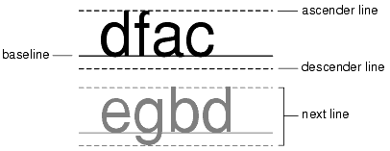
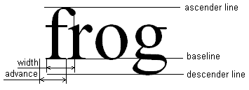
4- Measuring Text
A LineMetrics object encapsulates the measurement information associated with a Font, such as its ascent, descent, and leading.
The most common way to measure text is to use a FontMetrics instance which encapsulates this metrics information
Notes:
Ascent is the distance from the baseline to the ascender line. This distance represents the typical height of capital letters, but some characters might extend above the ascender line.
Descent is the distance from the baseline to the descender line. The lowest point of most characters will fall within the descent, but some characters might extend below the descender line.
Leading is the recommended distance from the bottom of the descender line to the top of the next line.

Slide 8
Demo 1- Draw Text
This demonstration depict how to:
Get system fonts
Create a font object
Assign a font object to graphics object
Draw text on a component
Get font metrics

Slide 9
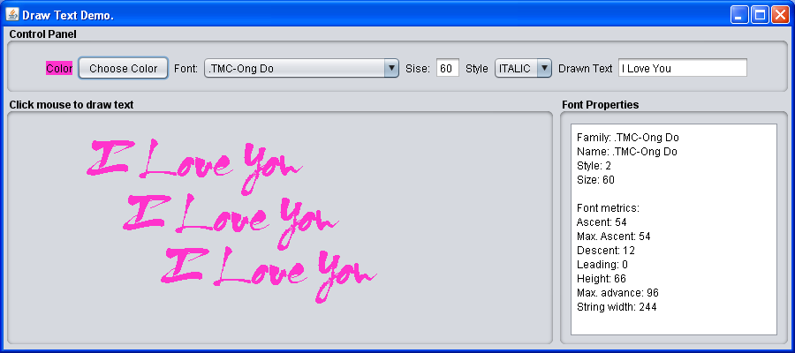
Demo 1- Draw Text
Get system fonts
Create a font object
Assign a font object to graphics object
Draw text on a component
Get font metrics
This demonstration depicts how to:

Slide 10
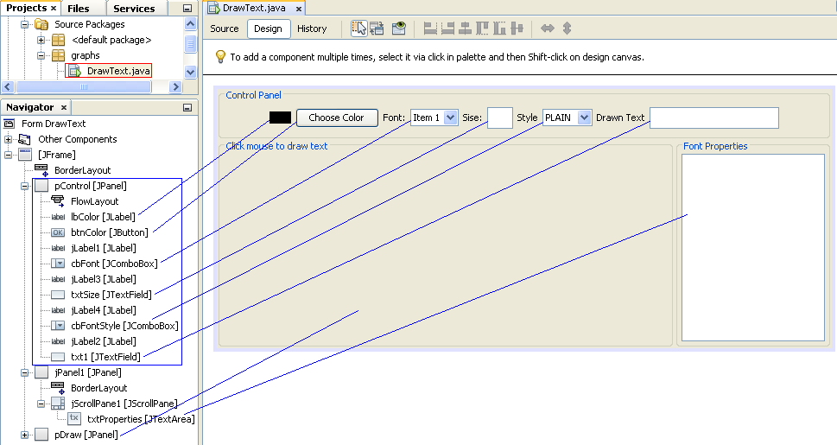
Demo 1: Design
Name: lbColor
Opaque: true
Text: Color
Background: Black
Name: cbFonStyle
Model: PLAIN, BOLD, ITALIC

Slide 11
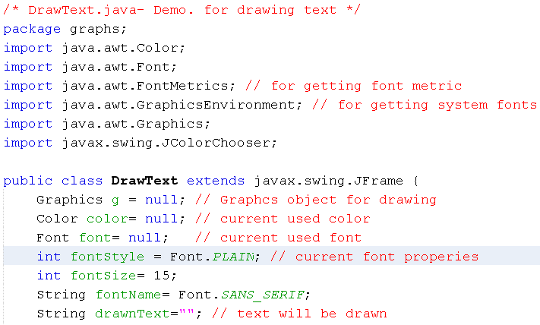
Demo 1: Code

Slide 12
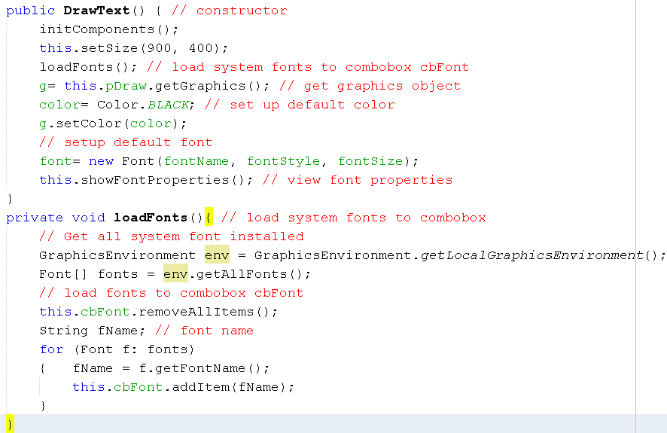
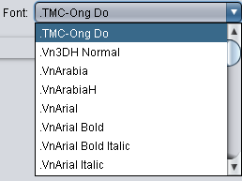
Demo 1: Code

Slide 13
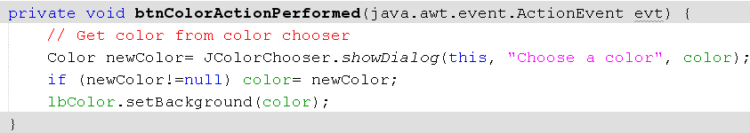
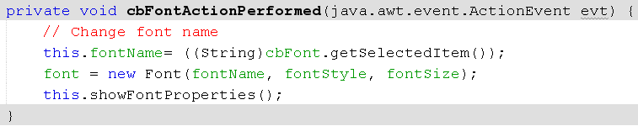
Demo 1: Code

Slide 14
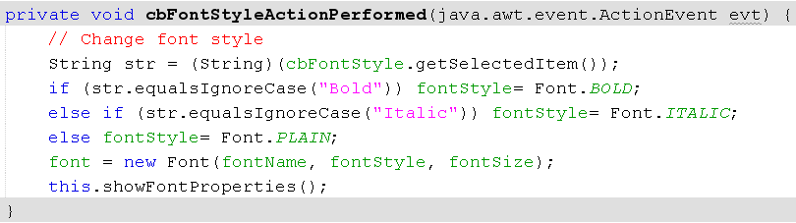
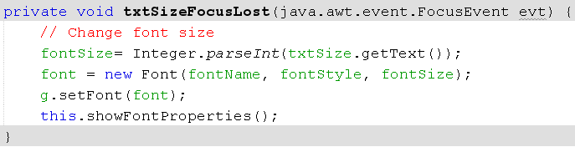

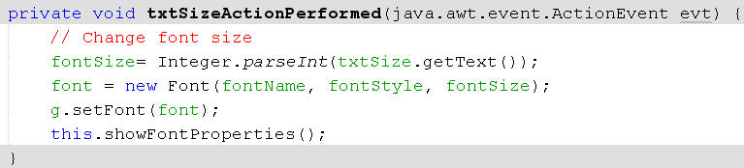
Demo 1: Code
When user enters preferred size then strikes the ENTER key

Slide 15
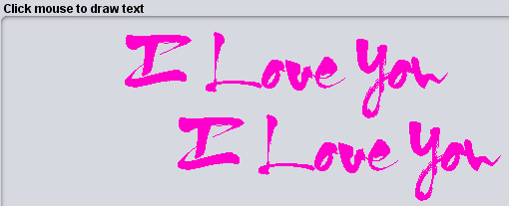
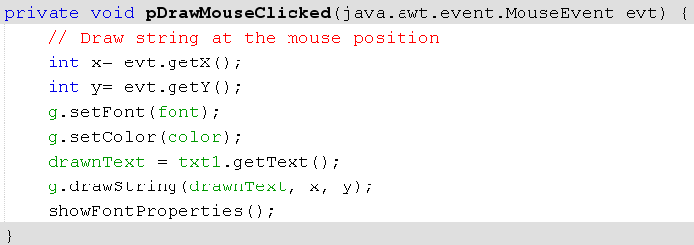
Demo 1: Code

Slide 16
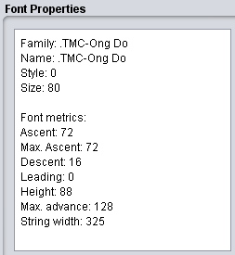
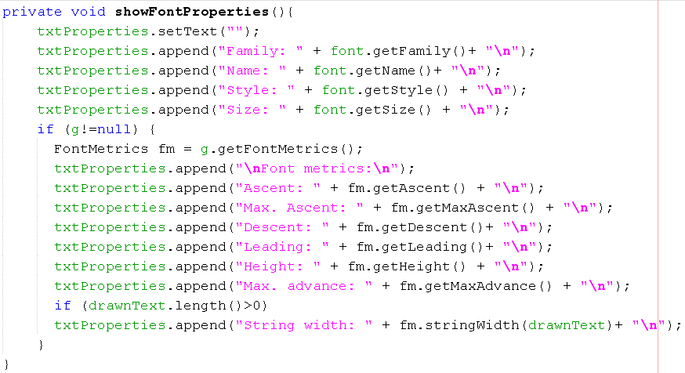
Demo 1: Code

Slide 17
Summary
Font Concepts
Physical and Logical Fonts
The java.awt.Font class
Measuring Text
Demonstrations

Slide 18
Thank You

